Slide 1
Breadth First Search (BFS) implementation
By Kunli Liu

Slide 2
BFS overview
When to choose BFS?
Level -> BFS
When to choose DFS?
Path -> DFS
DFS can be implemented with level information as well. But BFS is more intuitive for this purpose
1
Level 1
Level 2
2
3
DFS implementation:
BFS on binary tree
BFS on 2D grid
BFS on graph
Level 3
4
5
6
7

Slide 3
BFS implementation on Tree
Queue<TreeNode> queue = new LinkedList<>();
queue.add(root);
int level = 0;
while(!queue.isEmpty()) {
level++;
int count = queue.size();
for(int i = 0; i < count; i++) {
TreeNode current = queue.poll();
# process(current);
if(current.left != null) queue.add(current.left);
if(current.right != null) queue.add(current.right);
}
}
Initialize a queue, add the root into a queue
If the queue is not empty, it means there is at least one more level that is not yet explored
During the exploration of each level, keep track of the level number and the number of elements in that level. Add only not null elements into the queue

Slide 4
BFS implementation on Tree
Queue<TreeNode> queue = new LinkedList<>();
queue.add(root);
int level = 0;
while(!queue.isEmpty()) {
level++;
int count = queue.size();
for(int i = 0; i < count; i++) {
TreeNode current = queue.poll();
process(current);
if(current.left != null) queue.add(current.left);
if(current.right != null) queue.add(current.right);
}
}
Possible variations in implementation:
Count the number of elements in each level. Or sum all the elements in each level
In the original implementation, left element was added before the right element. This order can be reversed
Do something special for the first or last element in each level
Do something special for all the element at a particular level. If this operation will require the cooperation from its parents, then just traverse to its parents

Slide 5
104. Maximum Depth of Binary Tree
Given the root of a binary tree, return its maximum depth.
A binary tree's maximum depth is the number of nodes along the longest path from the root node down to the farthest leaf node.
Queue<TreeNode> queue = new LinkedList<>();
queue.add(root);
int level = 0;
while(!queue.isEmpty()) {
level++;
int count = queue.size();
for(int i = 0; i < count; i++) {
TreeNode current = queue.poll();
// process(current);
if(current.left != null) queue.add(current.left);
if(current.right != null) queue.add(current.right);
}
}
return level;

Slide 6
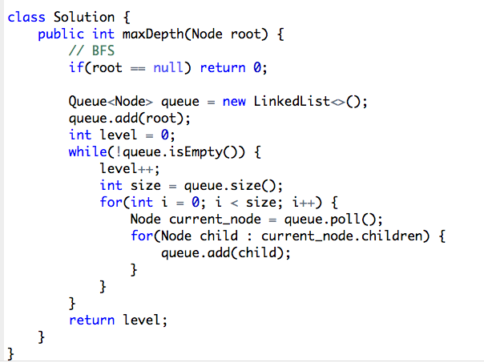
559. Maximum Depth of N-ary Tree
Given a n-ary tree, find its maximum depth.
The maximum depth is the number of nodes along the longest path from the root node down to the farthest leaf node.

Slide 7
111. Minimum Depth of Binary Tree
Given a binary tree, find its minimum depth.
The minimum depth is the number of nodes along the shortest path from the root node down to the nearest leaf node.
Note: A leaf is a node with no children.
Queue<TreeNode> queue = new LinkedList<>();
queue.add(root);
int level = 0;
while(!queue.isEmpty()) {
level++;
int count = queue.size();
for(int i = 0; i < count; i++) {
TreeNode current = queue.poll();
// process(current);
if(current.left == null && current.right == null) return level;
if(current.left != null) queue.add(current.left);
if(current.right != null) queue.add(current.right);
}
}

Slide 8
404. Sum of Left Leaves
Queue<TreeNode> queue = new LinkedList<>();
queue.add(root);
int level = 0;
while(!queue.isEmpty()) {
level++;
int count = queue.size();
for(int i = 0; i < count; i++) {
TreeNode current = queue.poll();
// process(current); check if the left child of current node is a left leaf
if(current.left != null && current.left.left == null && current.left.right == null) {
sum += current.left.val;
}
if(current.left != null) queue.add(current.left);
if(current.right != null) queue.add(current.right);
}
}
Traverse to the parent of the left leaf node, rather than to the left leaf node itself. Checking if some node is left leaf node, we need to know something about its parent

Slide 9
637. Average of Levels in Binary Tree
public List<Double> averageOfLevels(TreeNode root) {
List<Double> res = new ArrayList<>();
if(root == null) {
return res;
}
Queue<TreeNode> queue = new LinkedList<>();
queue.add(root);
while(!queue.isEmpty()) {
int count = queue.size();
double sum = 0;
for(int i = 0; i < count; i++) {
TreeNode node = queue.poll();
sum += node.val;
if (node.left != null) queue.add(node.left);
if (node.right != null) queue.add(node.right);
}
res.add(sum / count);
}
return res;
}
Given the root of a binary tree, return the average value of the nodes on each level in the form of an array.

Slide 10
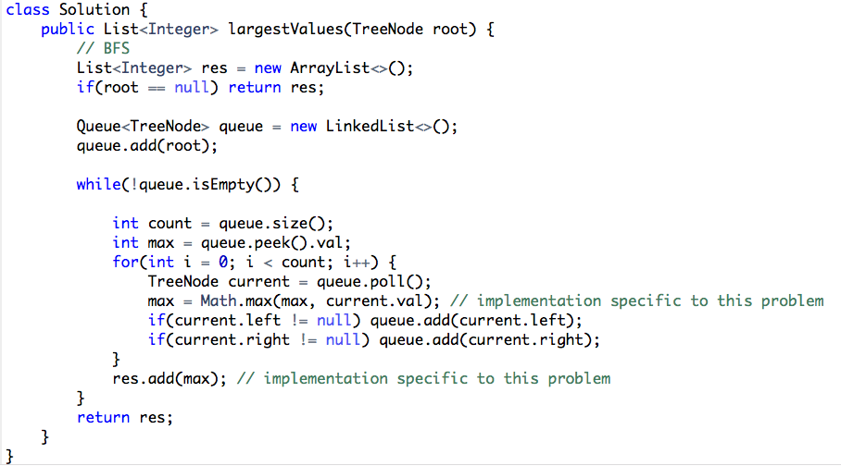
515. Find largest Value in Each Tree Row
Given the root of a binary tree, return an array of the largest value in each row of the tree (0-indexed).

Slide 11
513. Find Bottom Left Tree Value
Queue<TreeNode> queue = new LinkedList<>();
queue.add(root);
int level = 0;
while(!queue.isEmpty()) {
level++;
int count = queue.size();
for(int i = 0; i < count; i++) {
TreeNode current = queue.poll();
# process(current);
I f(i == 0) result = current.val;
if(current.left != null) queue.add(current.left);
if(current.right != null) queue.add(current.right);
}
}
Given the root of a binary tree, return the leftmost value in the last row of the tree.

Slide 12
102. Binary Tree Level Order Traversal
public List<List<Integer>> levelOrder(TreeNode root) {
List<List<Integer>> res = new ArrayList<>();
if(root == null) return res;
Queue<TreeNode> queue = new LinkedList<>();
queue.add(root);
while(!queue.isEmpty()) {
int count = queue.size();
List<Integer> current_list = new ArrayList<>();
for(int i = 0; i < count; i++) {
TreeNode current = queue.poll();
current_list.add(current.val);
if(current.left != null) queue.add(current.left);
if(current.right != null) queue.add(current.right);
}
res.add(current_list);
}
return res;
}
Given the root of a binary tree, return the level order traversal of its nodes' values. (i.e., from left to right, level by level).

Slide 13
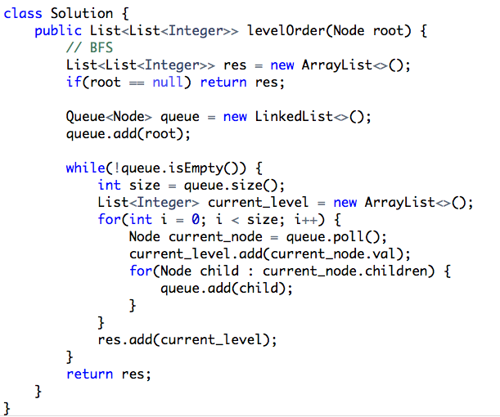
429. N-ary Tree Level Order Traversal
Given an n-ary tree, return the level order traversal of its nodes' values.

Slide 14
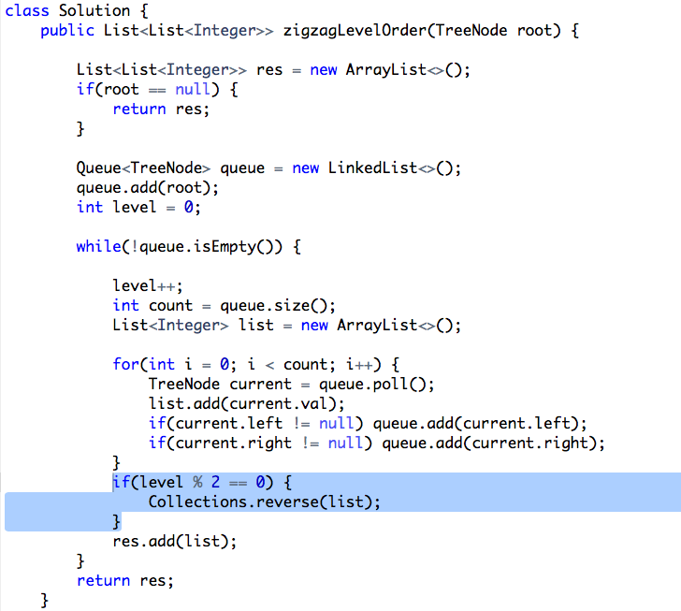
103. Binary Tree Zigzag Level Order Traversal
Given the root of a binary tree, return the zigzag level order traversal of its nodes' values. (i.e., from left to right, then right to left for the next level and alternate between).

Slide 15
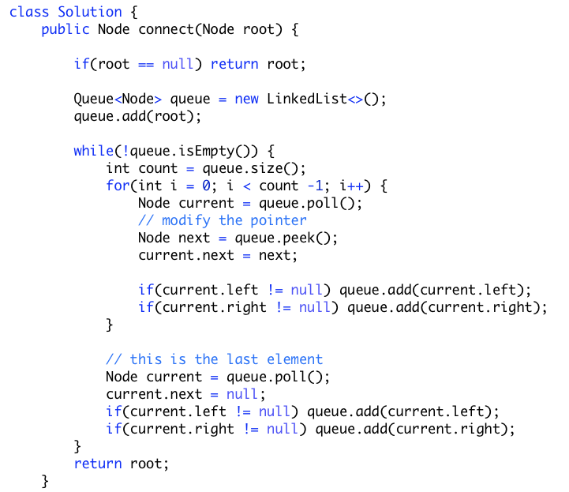
116. Populating Next Right Pointers in Each Node
Populate each next pointer to point to its next right node.
If there is no next right node, the next pointer should be set to NULL.

Slide 16
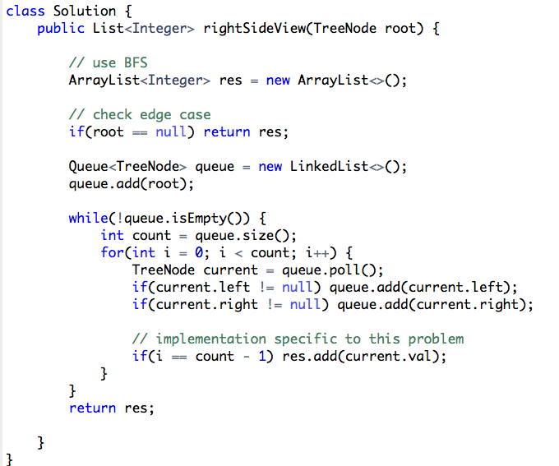
199. Binary Tree Right Side View
Given the root of a binary tree, imagine yourself standing on the right side of it, return the values of the nodes you can see ordered from top to bottom.

Slide 17
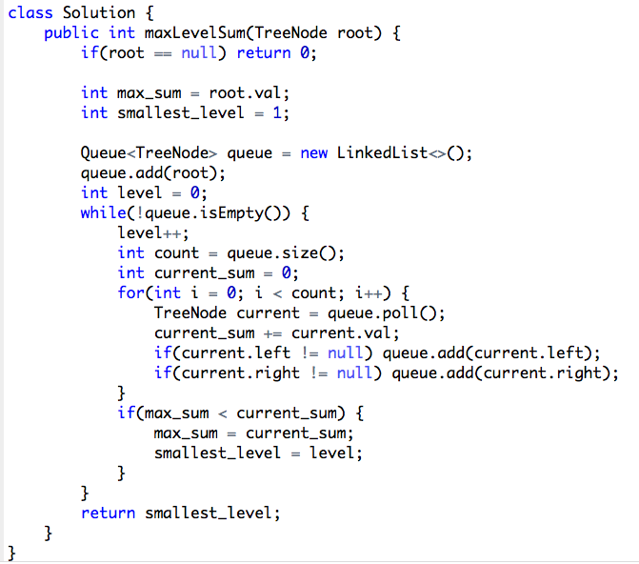
1161. Maximum Level Sum of a Binary Tree
Given the root of a binary tree, the level of its root is 1, the level of its children is 2, and so on.
Return the smallest level x such that the sum of all the values of nodes at level x is maximal.

Slide 18
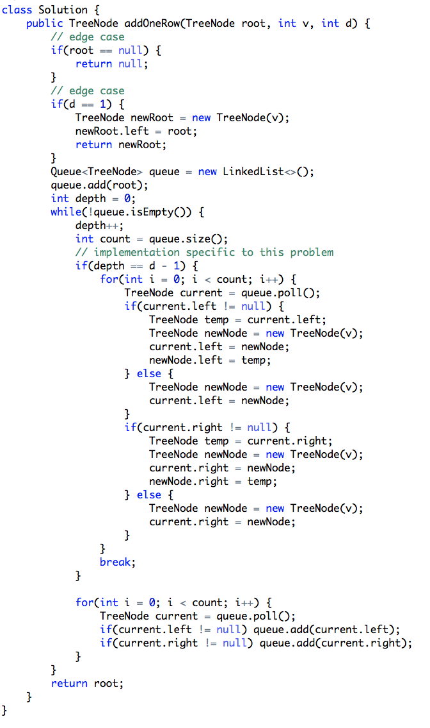
623. Add One Row To Tree
Given the root of a binary tree and two integers val and depth, add a row of nodes with value val at the given depth depth.
Note that the root node is at depth 1.
The adding rule is:
Given the integer depth, for each not null tree node cur at the depth depth - 1, create two tree nodes with value val as cur's left subtree root and right subtree root.
cur's original left subtree should be the left subtree of the new left subtree root.
cur's original right subtree should be the right subtree of the new right subtree root.
If depth == 1 that means there is no depth depth - 1 at all, then create a tree node with value val as the new root of the whole original tree, and the original tree is the new root's left subtree.

Slide 19
BFS implementation on 2D grid or graph: shortest distance
Key syntax
private int[][] directions = new int[][]{{-1, 0}, {1, 0}, {0, -1}, {0, 1}};
Queue<int[]> queue = new LinkedList<>();
queue.add(new int[]{x, y});
if(matrix == null || matrix.length == 0 || matrix[0].length == 0) return null;
int row = matrix.length;
int col = matrix[0].length
// in main function:
for(int i = 0; i < row; i++) {
for(int j = 0; j < col; j++) {
# DFS or BFS
# or add a set of elements into the queue of BFS (add it on certain condition)
}
}
// BFS implementation
while(!queue.isEmpty()) {
int[] current = queue.poll();
for(int[] direction : directions) {
int x = current[0] + direction[0];
int y = current[1] + direction[1];
if(x >= 0 && x < row && y >= 0 && y < col) {
queue.add(new int[]{x, y});
# processing
}
}
}
Key implementation details:
Use a 2D array to keep track of directions
In the main function, we either need to:
use two while loops and do DFS or BFS call on each cell
Or, add certain subset of cells into the queue of the BFS implementation
Or, run BFS from a certain cell
On BFS while loop, we first poll the indexes of the current cell from the que. Then loop through all the directions and find its neighbors. With the index of the neighbors, we first need to check if those indexes are within the boundary.

Slide 20
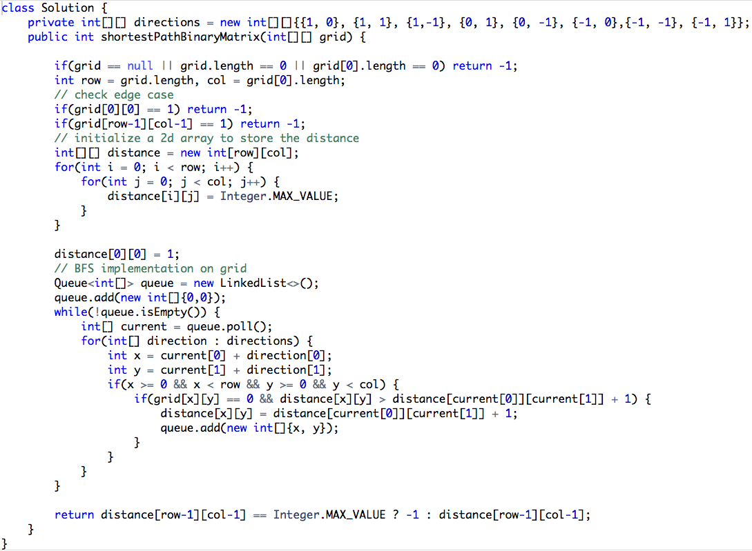
1091. Shortest Path in Binary Matrix
Given an n x n binary matrix grid, return the length of the shortest clear path in the matrix. If there is no clear path, return -1.
A clear path in a binary matrix is a path from the top-left cell (i.e., (0, 0)) to the bottom-right cell (i.e., (n - 1, n - 1)) such that:
All the visited cells of the path are 0.
All the adjacent cells of the path are 8-directionally connected (i.e., they are different and they share an edge or a corner).
The length of a clear path is the number of visited cells of this path.
Run BFS from the first cell

Slide 21
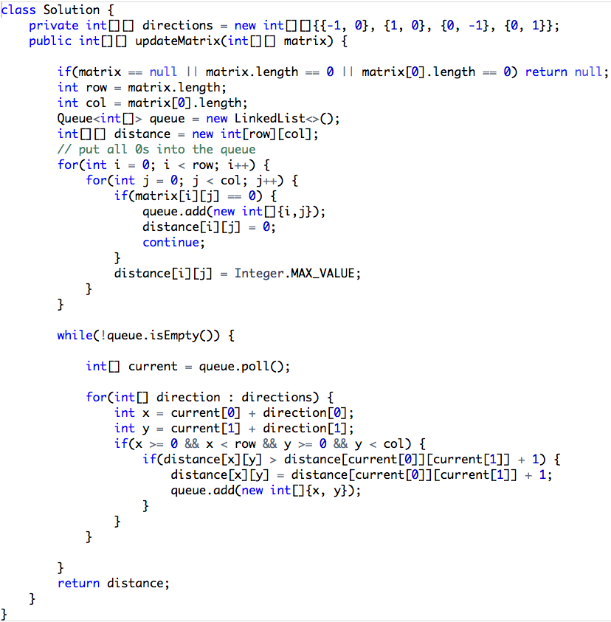
542. 0 1 Matrix
Given a matrix consists of 0 and 1, find the distance of the nearest 0 for each cell.
The distance between two adjacent cells is 1.
Add a set of elements into the queue on the main function

Slide 22
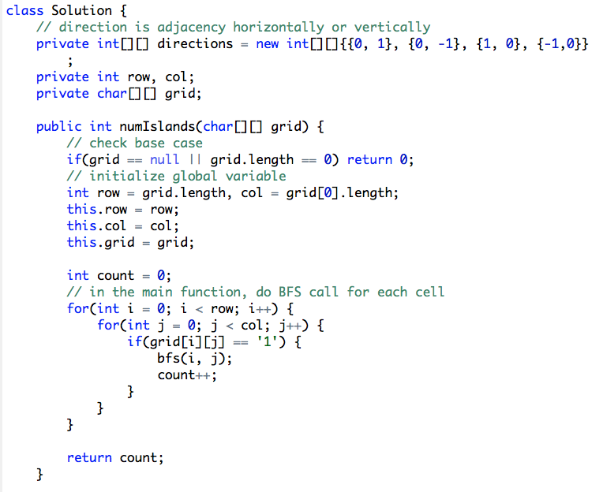
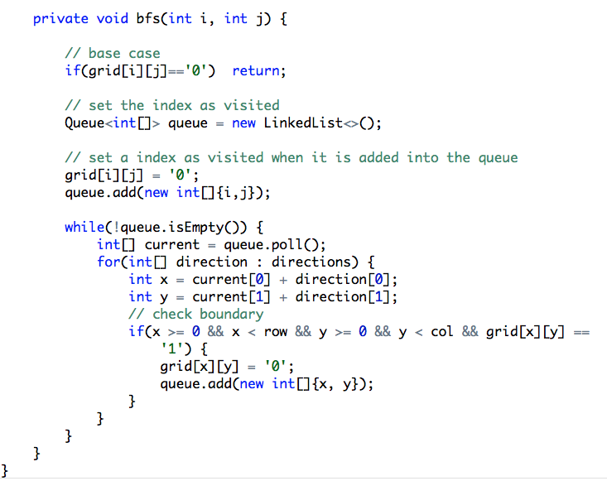
200. Number of Islands
Given an m x n 2D binary grid grid which represents a map of '1's (land) and '0's (water), return the number of islands.
An island is surrounded by water and is formed by connecting adjacent lands horizontally or vertically. You may assume all four edges of the grid are all surrounded by water.
use two while loops and do DFS or BFS call on each cell

Slide 23
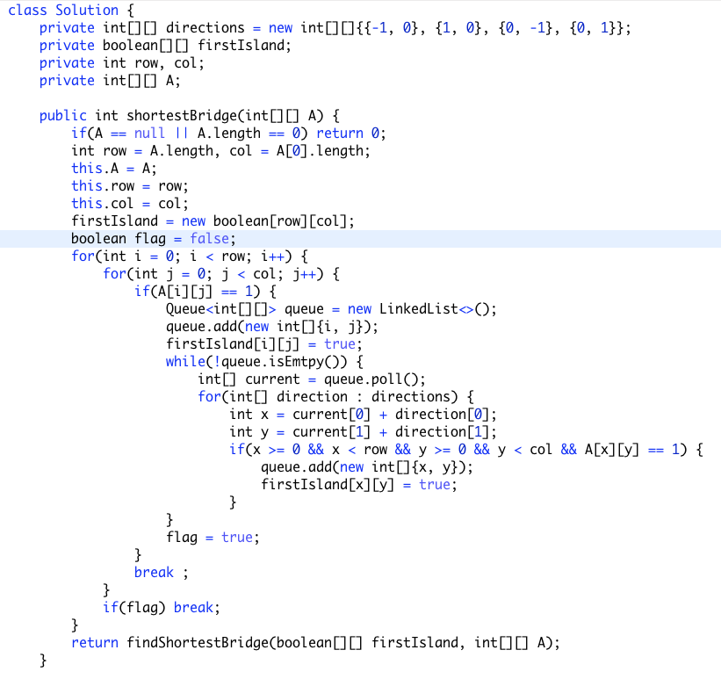
934. Shortest Bridge
Find the first bridge with BFS or DFS
Then add all the elements in the first bridge into a queue. Use BFS to find the minimum distance

Slide 24
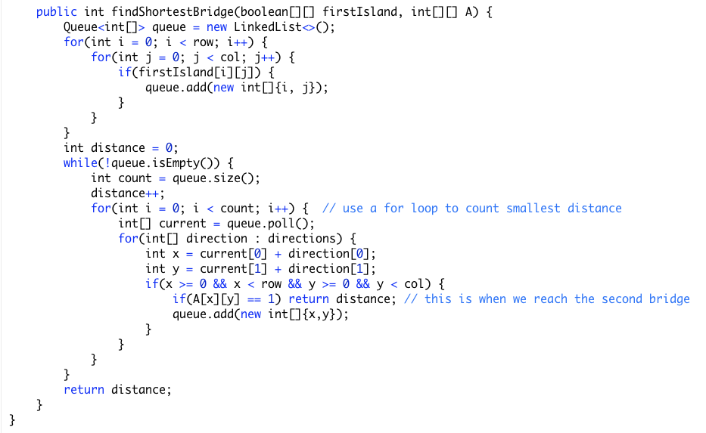
934. Shortest Bridge
Find the first bridge with BFS or DFS
Then add all the elements in the first bridge into a queue. Use BFS to find the minimum distance

Slide 25
Summary
We’ve covered BFS implementation in Tree, Grid
Tree implementation, grid implementation and graph implementation can be quite similar
When to use BFS? level, depth, shortest distance. Some of the shortest distance problem in grid can be conveniently solved with DP as well.

